Slide 1
Chapter 11
Money, Interest, and Income

Slide 2
The IS-LM Model
The IS curve shows combinations of interest rates
and levels of output such that planned spending equals income
The LM curve shows combinations of interest rates and levels of output such that money demand equals money supply → equilibrium in the money market

Slide 3
The Money Market and the LM Curve
The LM curve is derived in two steps:
Explain why money demand depends on interest rates and income
Theory of real money balances, rather than nominal
Equate money demand with money supply, and find combinations of income and interest rates that maintain equilibrium in the money market
(i, Y) pairs meeting this criteria are points on a given LM curve

Slide 4
Demand for Money
The demand for money is a demand for real money balances
People are concerned with how much their money can buy, rather than the number of dollars in their pockets
The demand for real balances depends on:
Real income: people hold money to pay for their purchases, which, in turn, depend on income
Interest rate: the cost of holding money
The demand for money is defined as: $L=kY−hi$

Slide 5
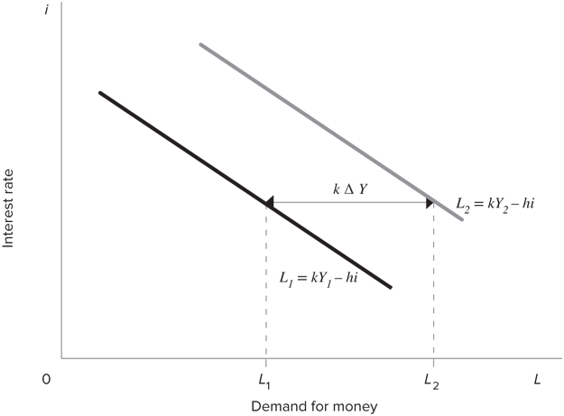
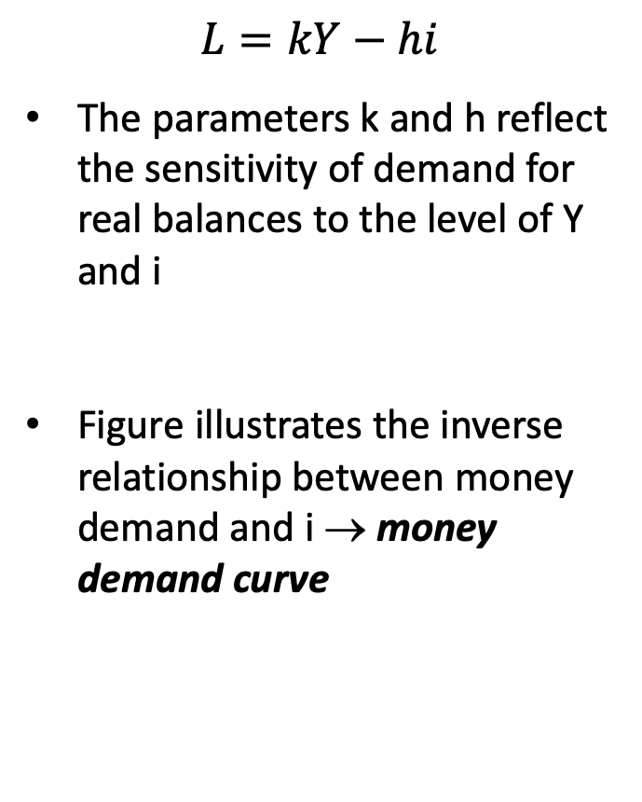
Demand for Money
$$L=kY−hi$$
The parameters k and h reflect the sensitivity of demand for real balances to the level of Y and i
Figure illustrates the inverse relationship between money demand and i → money demand curve

Slide 6
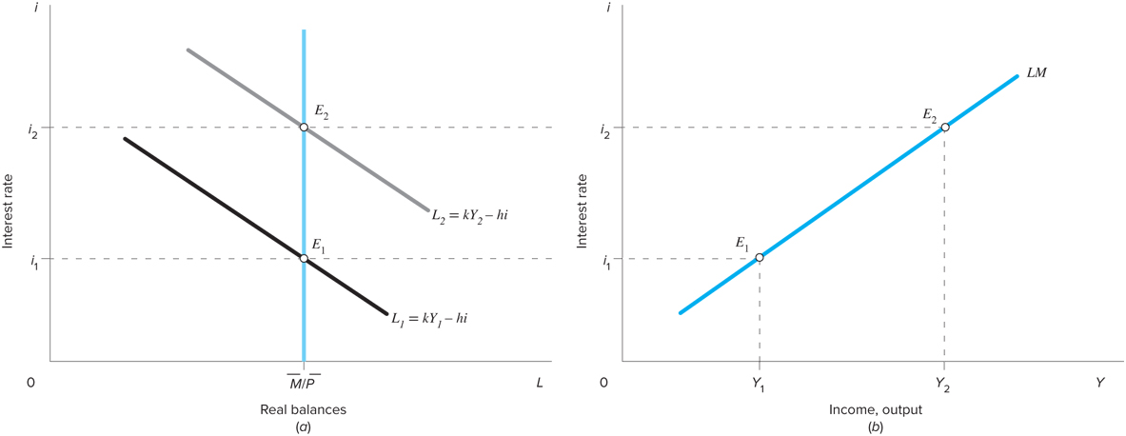
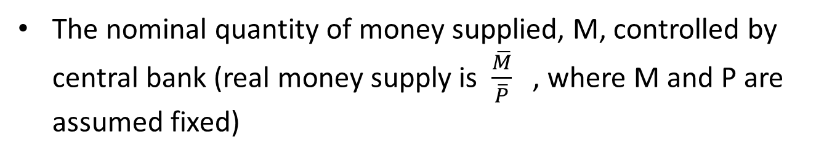
The Supply of Money, Money Market Equilibrium, and the LM Curve
The nominal quantity of money supplied, M, controlled by central bank (real money supply is $\frac{\overline{M}}{\overline{P}}$ , where M and P are assumed fixed)

Slide 7
The Supply of Money, Money Market Equilibrium, and the LM Curve
Starting at Y₁, the corresponding demand curve for real balances is L₁ → shown in panel (a)
Point E₁ is the equilibrium point in the money market

Slide 8
The Supply of Money, Money Market Equilibrium, and the LM Curve
Point E₁ is recorded in panel (b) as a point on the money market equilibrium schedule, or the LM curve
(i₁, Y₁) pair is a point on LM curve

Slide 9
The Supply of Money, Money Market Equilibrium, and the LM Curve
If income increases to Y₂, real money balances higher at every level of i → money demand shifts to L₂
The interest rate increases to i₂ to maintain equilibrium in money market and the new equilibrium is at point E₂

Slide 10
The Supply of Money, Money Market Equilibrium, and the LM Curve
Record E₂ in panel (b) as another point on the LM curve
Pair (i₂, Y₂) is higher up the given LM curve

Slide 11
The Supply of Money, Money Market Equilibrium, and the LM Curve
LM curve is positively sloped:
An increase in the interest rate reduces the demand for real balances
To maintain the demand for real money balances equal to the fixed supply, the level of income has to rise

Slide 12
The Supply of Money, Money Market Equilibrium, and the LM Curve
For the money market to be in equilibrium, supply must equal demand:
Solving for i:
The steeper the LM curve:
The greater the responsiveness of the demand for money to income, as measured by k
The lower the responsiveness of the demand for money to the interest rate, h

Slide 13
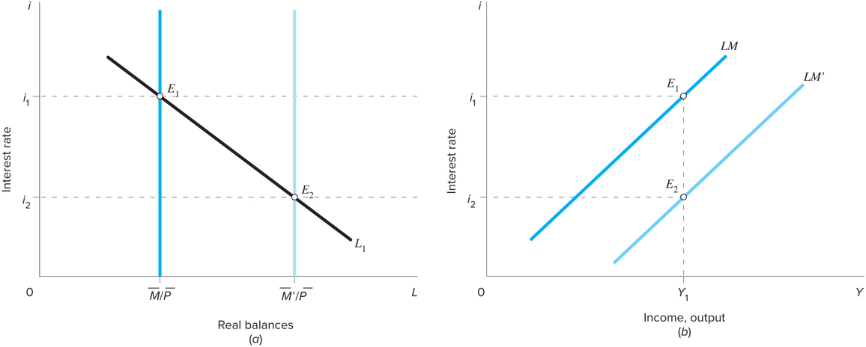
The Position of the LM Curve
Real money supply constant along the LM curve → a change in the real money supply will shift the LM curve
Figure shows the effect of an increase in money supply

Slide 14
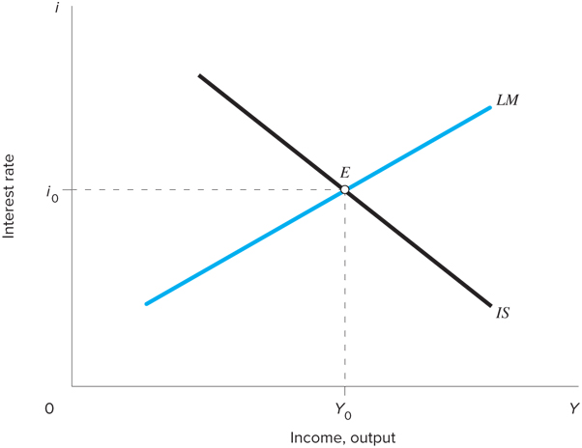
Equilibrium and the Goods and Money Market
The IS and LM schedules summarize the conditions that have to be satisfied for the goods and money markets to be in equilibrium
Assumptions:
Price level is constant
Firms willing to supply whatever amount of output is demanded at that price level
The equilibrium levels of income and the interest rate change when either the IS or the LM curve shifts

Slide 15
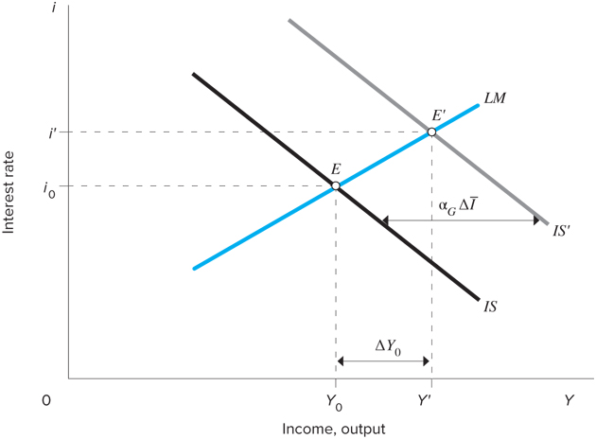
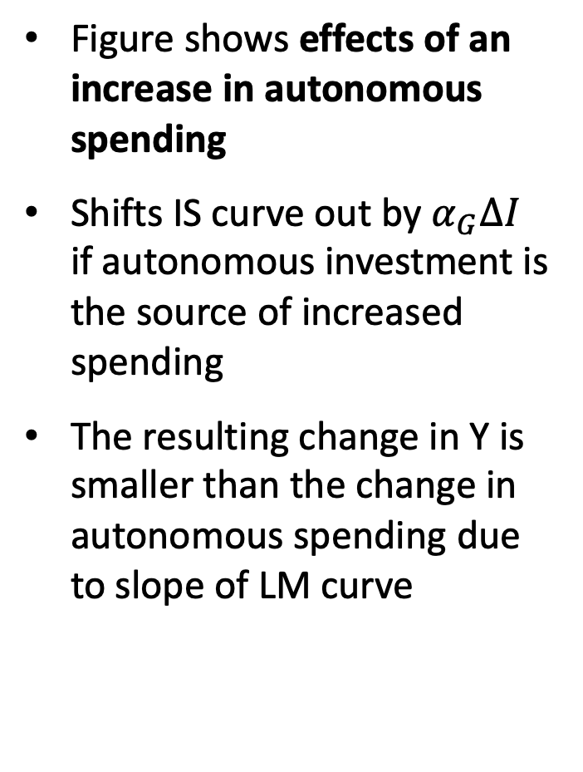
Changes in the Equilibrium
Figure shows effects of an increase in autonomous spending
Shifts IS curve out by $α_{G}∆I$ if autonomous investment is the source of increased spending
The resulting change in Y is smaller than the change in autonomous spending due to slope of LM curve

Slide 16
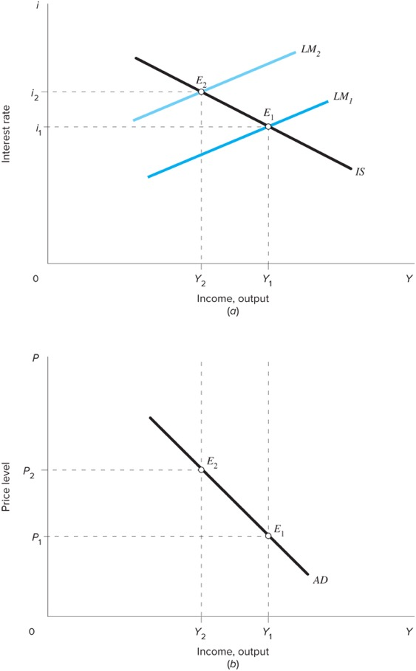
Deriving the AD Schedule
The AD schedule maps out the IS-LM equilibrium holding autonomous spending and the nominal money supply constant and allowing prices to vary
Suppose prices increase from P₁ to P₂
M/P decrease from M/P₁ to M/P₂ → LM decreases from LM₁ to LM₂

Slide 17
Deriving the AD Schedule
Derive the equation for the AD curve using the equations for the IS-LM curves:
Substituting LM equation into the IS equation:

Slide 18
Deriving the AD Schedule
Equation shows that AD depends upon:
Autonomous spending
Real money stock
Equilibrium income is:
Higher the higher the level of autonomous spending
Higher the higher the stock of real balances

Slide 19

Example
The following equations describe an economy:
C = 0.8(1-t)Y
t = 0.25
I = 900 – 50i
$\overline{G}$ = 800
$$L = 0.25Y − 62.5i$$
$$\frac{\overline{M}}{\overline{P}} = 500$$
What is the equation that describes the IS curve?
What is the equation that describes the LM curve?
What are the equilibrium levels of income and interest rate?

